Slide 1

Quantum Shannon Theory
Aram Harrow (MIT)
QIP 2016 tutorial
9-10 January, 2016

Slide 2
the prehistory of quantum information
ideas present in disconnected form
1927 Heisenberg uncertainty principle
1935 EPR paper / 1964 Bell’s theorem
1932 von Neumann entropy subadditivity (Araki-Lieb 1970) strong subadditivity (Lieb-Ruskai 1973)
measurement theory (Helstrom, Holevo, Uhlmann, etc., 1970s)
Notes:
H uncertainty principle – relates to measurements, linewidths, etc. quantized action (“old quantum mechanics”)
EPR, Bell entanglement – relates to foundations, i.e. the question of whether QM could be an effective theory.
vN entropy Lieb-Ruskai (Petz, etc.) – SSA – q stat mech, technical questions about how entropy works in the quantum case.
Holevo, Helstrom, etc – measurement. semi-classical information theory.

Slide 3
relativity: a close relative
Before Einstein, Maxwell’s equations were known to be incompatible with Galilean relativity.
Lorentz proposed a mathematical fix, but without the right physical interpretation.
Einstein’s solution redefined space/time, mass/momentum/energy, etc.
Space and time had solid mathematical foundations (Descartes, etc.), unlike information and computing.

Slide 4
theory of information and computing
1948 Shannon created modern information theory (and to some extent cryptography) and justified entropy as a measure of information independent of physics. units of bits.
Turing, Church, von Neumann, ..., Djikstra described a theory of computation, algorithms, complexity, etc.
This made it possible to formulate questions such as: how do “quantum effects” change the capacity? (→ Holevo bound) what is the thermodynamic cost of computing? (Landauer principle, Bennett reversible computing) what is the computational complexity of simulating QM? (→ DMRG/QMC, and also Feynman)

Slide 5
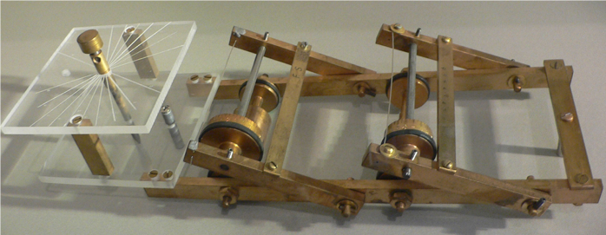
some wacky ideas
Feynman ’82: “Simulating Physics with Computers”
Classical computers require exponential overhead to simulate quantum mechanics.
But quantum systems obviously don’t need exp overhead to simulate themselves.
Therefore they are doing something more computationally powerful than our existing computers.
(Implicitly requires the idea of a universal Turing machine, and the strong Church-Turing thesis.)
Wiesner ’70: “Conjugate Coding”
The uncertainty principle restricts possible measurements.
In experiments, this is a disadvantage, but in crypto, limiting information is an advantage.
(Requires crypto framework, notion of “adversary.”)
Paper initially rejected by IEEE Trans. Inf. Th. ca. 1970

Slide 6
towards modern QIT
Deutsch, Jozsa, Bernstein, Vazirani, Simon, etc. – impractical speedups required oracle model, precursors to Shor’s algorithm, following Feynman.
quantum key distribution (BB84, B90, E91) – following Weisner.
ca. 1995
Shor and Grover algorithms
quantum error-correcting codes
fault-tolerant quantum computing
teleportation, super-dense coding
Schumacher-Jozsa data compression
HSW coding theorem
resource theory of entanglement

Slide 7
modern QIT
semiclassical
compression: S(ρ) = -tr [ρlog(ρ)]
CQ or QC channels: χ({p_{x},ρ_{x}}) = S(∑_{x} p_{x}ρ_{x}) - ∑_{x}p_{x}S(ρ_{x})
hypothesis testing: D(ρ||σ) = tr[ρ(log(ρ) - log(σ)]
“fully quantum”
complementary channel: N(ρ) = tr₂ VρV†, N^{c}(ρ) := tr₁ VρV†
quantum capacity: Q⁽¹⁾(N) = max_{ρ} [S(N(ρ)) - S(N^{c}(ρ))] Q(N) = lim_{n→∞} Q⁽¹⁾(N^{⊗n})/n
tools: purifications (Stinespring), decoupling
recent
one-shot: S_{α}(ρ) := log(tr ρ^{α})/(1-α)
applications to optimization, condensed matter, stat mech.

Slide 8
Relevant talks
Wed 9. Omar Fawzi and Renato Renner. Quantum conditional mutual information and approximate Markov chains.
Wed 9:50. Omar Fawzi, Marius Junge, Renato Renner, David Sutter, Mark Wilde and Andreas Winter. Universal recoverability in quantum information theory.
Thurs 11. David Sutter, Volkher Scholz, Andreas Winter and Renato Renner. Approximate degradable quantum channels
Thurs 4:15. Mario Berta, Joseph M. Renes, Marco Tomamichel, Mark Wilde and Andreas Winter. Strong Converse and Finite Resource Tradeoffs for Quantum Channels.

Slide 9
semi-relevant talks
Tues 11:50. Ryan O'Donnell and John Wright. Efficient quantum tomography merged with Jeongwan Haah, Aram Harrow, Zhengfeng Ji, Xiaodi Wu and Nengkun Yu. Sample-optimal tomography of quantum states
Tues 3:35. Ke Li. Discriminating quantum states:the multiple Chernoff distance
Thurs 10. Mark Braverman, Ankit Garg, Young Kun Ko, Jieming Mao and Dave Touchette. Near optimal bounds on bounded-round quantum communication complexity of disjointness
Thurs 3:35. Fernando Brandao and Aram Harrow. Estimating operator norms using covering nets with applications to quantum information theory
Thurs 4:15. Michael Beverland, Gorjan Alagic, Jeongwan Haah, Gretchen Campbell, Ana Maria Rey and Alexey Gorshkov. Implementing a quantum algorithm for spectrum estimation with alkaline earth atoms.

Slide 10
outline
metrics
compressing quantum ensembles (Schumacher coding)
sending classical messages over q channels (HSW)
remote state preparation (RSP)
Schur duality
RSP and the strong converse
hypothesis testing
merging
quantum conditional mutual information and q Markov states

Slide 11
metrics
Trace distance T(ρ,σ) := ½ || ρ-σ ||₁
Is a metric.
monotone: T(ρ,σ) ≥ T(N(ρ),N(σ))
and this is achieved by a measurement → T = max m’mt bias
Fidelity
F=1 iff ρ=σ and F=0 iff ρ⊥σ
monotone F(ρ,σ) ≤ F(N(ρ),N(σ))
and this is achieved by a measurement!
Relation: 1-F ≤ T ≤ (1-F²)^{1/2}
Pure states with angle θ:
F = cos(θ) and T = sin(θ). (exercise: which m’mts saturate?)

Slide 12
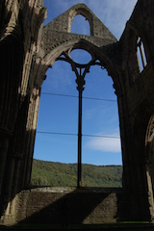
the case for fidelity
Uhlmann’s theorem: F(ρ_{A}, σ_{A}) = max_{ψ,φ} F(ψ_{AB}, φ_{AB}) s.t. ψ=|ψ⟩⟨ψ|, φ=|φ⟩⟨φ|, ψ_{A} = ρ_{A}, φ_{A} = σ_{A}.
Church
of the
Larger
Hilbert
Space
Note:
≥ from monotonicity. = requires sweat
Can fix either ψ or φ and max over the other.
F(ψ,φ) = |⟨ψ|φ⟩|. (Some use different convention.)
Implies that (1-F)^{1/2} is a metric.
Also F is multiplicative.

Slide 13
Compression
|ψ_{x}⟩∈C^{d} with prob p_{x}
encoder
decoder
≈|ψ_{x}⟩
dim r < d
Average fidelity: ∑_{x} p_{x} F(ψ_{x}, D(E(ψ_{x}))) ≤ F(ρ, D(E(ρ)))
Simplification: use ensemble density matrix ρ = ∑_{x} p_{x} ψ_{x} with eigenvalues λ₁ ≥ λ₂ ≥ ... ≥ λ_{d} ≥ 0
rank(σ)=r ⇒ F(ρ,σ)² ≤ tr [P_{r}ρ] = λ₁ + ... + λ_{r} P_{r} projects onto top r eigenvectors
Suggests optimal fidelity = (λ₁ + ... + λ_{r})^{1/2}.

Slide 14
Too good to be true!
Ensemble density matrix: ρ = ∑_{x} p_{x} ψ_{x}
Yes compression depends only on ρ.
But reproducing ρ is not enough!
consider: E(∙)=|0⟩⟨0|
D(∙)=ρ
Gets the average right but not the correlations.

Slide 15
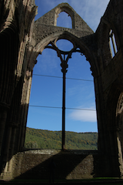
Reference system
Average fidelity: ∑_{x} p_{x} F(ψ_{x}, E(D(ψ_{x})))
= F(∑_{x} p_{x} |x⟩⟨x| ⊗ ψ_{x}, ∑_{x} p_{x} |x⟩⟨x| ⊗ E(D(ψ_{x})))
Not so easy to analyze.
Instead follow the Church of the Larger Hilbert Space.
Avg fidelity ≥ F(𝜑, (id_{R} ⊗ D∘E_{Q})(𝜑))
(pf: monotonicity under map that measures R.)
Protocol: E(ω) = P_{r} ω P_{r}. D = id.
achieves F = ⟨𝜑| (I ⊗ P_{r}) |𝜑⟩ = tr [ρP_{r}] = λ₁ + ... + λ_{r}

Slide 16
Optimality
Complication: E, D might be noisy.
Solution: purify!
1. Write D(E(ω)) = tr_{G} VωV†
where V is an isometry from Q -> Q⊗G.
2. Uhlmann →
F(𝜑, tr_{G} V𝜑V†) = |⟨𝜑|_{RQ}⟨0|_{G} V |𝜑⟩_{RQ}|
3. a little linear algebra → F ≤ tr[ρP] for P rank-r and ||P||≤1
≤ λ₁ + ... + λ_{r}

Slide 17
compressing i.i.d. sources
Quantum story ≈ classical story
ρ^{⊗n} has eigenvalues λ_{x1} λ_{x2} ⋅⋅⋅ λ_{xn} for X=(x₁,...,x_{n}) ∈ [d]^{n} .
Typically this is ≈
H(λ) = -∑_{x} λ_{x} log(λ_{x}) = S(ρ) = -tr[ρlog(ρ)]
distribution of -log(λ_{x1} λ_{x2} ⋅⋅⋅ λ_{xn} )
qubits | fidelity
nH(λ) + 2σn^{1/2} | 0.98
nH(λ) - 2σn^{1/2} | 0.02
n(H(λ)+δ) | 1-exp(-nδ²/2σ²)
n(H(λ)-δ) | exp(-nδ²/2σ²)
nH(λ)
σ²=∑_{x} λ_{x} (log(1/λ_{x})-H)²

Slide 18
typicality
Definitions: An eigenvector of ρ^{⊗n} is k-typical if its eigenvalue is in the range exp(-nS(ρ) ± kσn^{1/2}).
Typical subspace V = span of typical eigenvectors
Typical projector P = projector onto V
Structure theorem for iid states: “asymptotic equipartition”
tr [Pρ^{⊗n}] ≥ 1 – k⁻²
exp(-nS(ρ) - kσn^{1/2}) P ≤ Pρ^{⊗n} P ≤ exp(-nS(ρ) + kσn^{1/2}) P
likewise tr[P] ≈ exp(nS(ρ) + kσn^{1/2})
Almost flat spectrum. Plausible because of permutation symmetry.

Slide 19
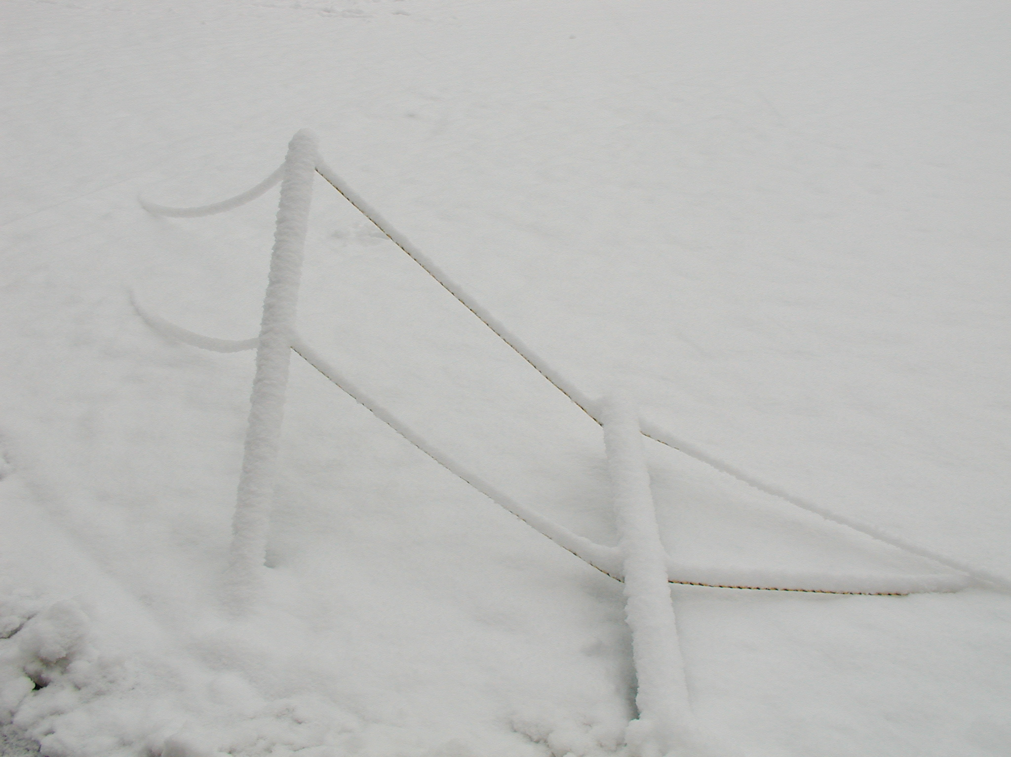
Quantum Shannon Theory
Aram Harrow (MIT)
QIP 2016 tutorial day 2
10 January, 2016

Slide 20
entropy
S(A|B)
S(ρ) = -tr [ρlog ρ]
range: 0 ≤ S(ρ) ≤ log(d)
symmetry: S(ρ) = S(UρU†)
multiplicative: S(ρ⊗σ) = S(ρ) + S(σ)
continuity (Fannes-Audenaert): | S(ρ) – S(σ) | ≤ εlog(d) + H(ε,1-ε) ε := || ρ – σ ||₁ / 2
A
B
I(A:B)
A
B
multipartite systems: ρ_{AB} S(A) = S(ρ_{A}), S(B) = S(ρ_{B}), etc.
conditional entropy: S(A|B) := S(AB) – S(B), can be < 0
mutual information: I(A:B) = S(A) + S(B) – S(AB) = S(A) – S(A|B) = S(B) – S(B|A) ≥ 0 “subadditivity”

Slide 21
CQ channel coding
CQ = Classical input, Quantum output
N
|x⟩⟨x|
ρ_{x} = N(|x⟩⟨x|)
Given n uses of N, how many bits can we send?
Allow error that →0 as n →∞.
HSW theorem: Capacity = maxχ
χ({p_{x},ρ_{x}}) = S(∑_{x} p_{x}ρ_{x}) - ∑_{x}p_{x}S(ρ_{x})
ω_{XQ} = ∑_{x} p_{x} |x⟩⟨x| ⊗ρ_{x}
χ = I(X;Q)_{ω} = S(Q) – S(Q|X)

Slide 22
HSW coding
ρ = Σ_{x} p_{x} ρ_{x}
χ = S(ρ) - Σ_{x} p_{x} S(ρ_{x})
= S(Q) – S(Q|X)
ambiguity in each message
total
information
If x=(x₁,...,x_{n}) is p-typical then ρ_{x1} ⊗ρ_{x2} ⊗ ... ⊗ρ_{xn} has typical subspace of dim ≈ exp(n∑_{x} p_{x} S(ρ_{x}))
typical subspace of ρ⊗^{n} has dim ≈exp(n S(ρ))
“Packing lemma” Can fit ≈exp(nχ) messages.

Slide 23
Packing lemma
Classically: random coding and maximum-likelihood decoding
Quantumly: messages do not commute with each other
Suppose σ=Σ_{x} p_{x} σ_{x} and there exist Π, {Π_{x}} s.t.
tr[Πσ_{x}] ≥ 1-ε
tr[Π_{x}σ_{x}] ≥ 1-ε
tr[Π_{x}] ≤ d
ΠσΠ ≤ Π / D
density ≤ 1/D
size ≤ d
Packing lemma: We can send M messages with error O(ε^{1/2} + Md/D)
For HSW:
σ=ρ^{⊗n} with typ proj Π. D ≈ exp(n S(Q))
σ_{x} = ρ_{x1} ⊗ ... ⊗ρ_{xn} with typ proj Π_{x}. d ≈ exp(n S(Q|X)).

Slide 24
Upper bound
∑_{Y} D_{Y} = I
X∈{X¹, ..., X^{M}}
ρ_{X} = ρ_{x1} ⊗ ... ⊗ρ_{xn}
N^{⊗n}
D
Y
Q
Pr[Y|X] = tr[ρ_{X}D_{Y}]
proof: nχ ≥ I(X;Q) ≥ I(X;Y) ≥ (1-O(ε)) log(M)
additivity
Wed 10:50 Cross-Li-Smith. also Shannon 1948
continuity
data-processing inequality
V_{D}
Y
I(X:Q) = I(X:YQ’) ≥ I(X:Y)
Q
D
≅
Q
Y
Q’
isometry

Slide 25
conditional mutual information
Claim that I(A:BC) - I(A:B) ≥ 0.
=: I(A:C|B) conditional mutual information
= S(A|B) + S(C|B) – S(AC|B)
= S(AB) + S(BC) – S(ABC) – S(B)
B
A
CMI
C
If B is classical, ρ = ∑_{b} p(b) |b⟩⟨b| ⊗ σ(b)_{AC} then I(A:C|B) = ∑_{b} p(b) I(A:C)_{σ(b)} ≥ 0 from subadditivity
I(A:C|B) ≥ 0 is strong subadditivity [Lieb-Ruskai ’73]. I(A:C|B) = 0 for “quantum Markov states” Wed morning you will hear I(A:C|B) ≥ “non-Markovianity”

Slide 26
capacity of QQ channels
Additional degree of freedom: channel inputs |ψ_{x}⟩.
C⁽¹⁾(N) = max_{{px,ψx}} χ({p_{x},ψ_{x}})
NP-hard optimization problem [Beigi-Shor, H.-Montanaro]
Worse: C(N) = lim_{n→∞} C⁽¹⁾(N^{⊗n})/n.
and ∃ channels where C(N) > C⁽¹⁾(N).
Open questions: Non-trivial upper bounds on capacity.
Strong converse (p_{succ} -> 0 when sending n(C+δ) bits.) (see Berta et al, Thurs 4:15pm).

Slide 27
quantum capacity
How many qubits can be sent through a noisy channel?
R
R
N
V_{N}
B
A
B
≅
A
E
isometry
Q⁽¹⁾(N) := max S(B) – S(E)
= max S(B) – S(RB)
= max –S(R|B)
Q(N) = lim_{n→∞} Q⁽¹⁾(N^{⊗n})/n
not known when > 0.
sometimes Q⁽¹⁾(N)= 0 < Q(N).
“coherent information”

Slide 28
entanglement-assisted capacity
Alice and Bob share unlimited free EPR pairs.
R
R
C_{E}(N) = max I(R:B)
Bennett
Shor
Smolin
Thapliyal q-ph/0106052
Q_{E}(N) = C_{E}(N)/2
V_{N}
B
A
E
additive
concave in input
→ efficiently computable

Slide 29
covering lemma
Suppose σ=Σ_{x} p_{x} σ_{x} and there exist Π, {Π_{x}} s.t.
tr[Πσ_{x}] ≥ 1-ε
tr[Π_{x}σ_{x}] ≥ 1-ε
tr[Π] ≤ D
Π_{x}σ_{x}Π_{x} ≤ Π_{x} / d
size ≤ D
density≤ 1/d
Covering lemma: If x₁, ..., x_{M} are sampled randomly from p
and M >> (D/d) log(D)/ε³ then with high probability

Slide 30
wiretap (CQQ) channel
N
B
X
ρ^{x}_{BE} = N(|x⟩⟨x|)
E
Thm: Alice can send secret bits to Bob at rate I(X:B) – I(X:E).
Proof: packing lemma -> coding ≈nI(X:B) bits for Bob covering lemma -> sacrifice ≈nI(X:E) bits to decouple Eve

Slide 31
remote state preparation (RSP)
Q: Cost to transmit n qubits?
A: 2n cbits, n ebits using teleportation.
Cost is optimal given super-dense coding and entanglement distribution.
visible coding: What if the sender knows the state?
We want to simulate the map: “ψ” → |ψ⟩. Requires ≥n cbits, but above optimal arguments break.

Slide 32
RSP via covering
Consider the ensemble {UψU†} for random U.
Average state is I/2^{n}.
Covering-type arguments [Aubrun arXiv:0805.2900] → If we choose U₁, ..., U_{M} randomly with M >> 2^{n} / ε² then
with high probability, ∀ψ
Set
Then (1-ε)I ≤ ∑_{i} E_{i} ≤ I
So {E_{i}} is ≈ a valid measurement. So what?

Slide 33
RSP finally
recall
Lemma: (A⊗I)|Φ_{d}⟩ = (I ⊗ A^{T})|Φ_{d}⟩
Protocol:
{E_{i}^{T}}
discard
i
|Φ₂n⟩_{AB}
U_{i}†
|ψ⟩
∝E_{i}^{T} ⊗ E_{i} ∝ (U_{i}ψU_{i}†)^{T} ⊗ (U_{i}ψU_{i}†)
cost ≈ n cbits + n ebits.

Slide 34
RSP of ensembles
can simulate x -> ρ_{x} with cost χ
≈nχ cbits + some ebits ≥ N^{⊗n} ≥ ≈nχcbits
Lemma: Converting n(C-δ) cbits + ∞ ebits into nC cbits will have success probability ≤exp(-nδ).
implies strong converse: sending n(χ+δ) bits through N^{⊗n} has exp(-nδ’) success prob

Slide 35
simulation and strong converses
Let N be a general q channel.
Type of simulation | cbit simulation cost | also needs
visible product input | χ | EPR
visible arbitrary input | R | EPR
arbitrary quantum input | C_{E} | embezzling
R is “strong converse rate”; i.e. min s.t. sending n(R+δ) bits has success prob ≤ exp(-nδ’)
χ ≤ C ≤ R ≤ C_{E}

Slide 36
merging and decoupling
|ω⟩_{RA’MB}
Reference
R
A’
A
U
|ψ⟩_{RAB}
|ψ⟩_{RAB}
M
|Φ⟩
Alice
B’
Bob
V
B
AB
Let |ω⟩ = U|ψ⟩.
Claim: All we need is ω_{RA’} ≈ ω_{R} ⊗ ω_{A’}.
Pf: The LHS is purified by |ω⟩ and the RHS by |ψ⟩_{RAB}|Φ⟩_{A’B’}
Uhlmann’s theorem says ∃V:MB → ABB’ making these close.

Slide 37
state redistribution
[Luo-Devetak, Devetak-Yard]
Reference
R
A
A
U
|ψ⟩_{RABC}
C
A’
|Φ⟩
|ψ⟩_{RABC}
Alice
M
B’
Bob
V
B
BC
|M| = ½ I(C:R|B) = ½ I(C:R|A) qubits communicated
entanglement consumed/created = H(C|RB)

Slide 38
quantum Markov states
relabel
A
B
C
E
Bob can “redistribute” C to E with ½ I(A:C|B) qubits.
If I(A:C|B)=0 then this is reversible!
Implies recovery map R : B -> BC such that
(id_{A} ⊗ R_{B->BC})(ρ_{AB}) = ρ_{ABC}
structure theorem: I(A:C|B)=0 iff
B¹_{L} |  | B¹_{R}
B²_{L} | B²_{R}
B³_{L} |  | B³_{R}
B⁴_{L} | B⁴_{R}
A
C

Slide 39
approximate Markov states
towards a structure thm: [Fawzi-Renner 1410.0664, others]
If I(A:C|B) ≈ 0 then ∃approximate recovery map R, i.e. (id_{A} ⊗ R_{B->BC})(ρ_{AB}) ≈ ρ_{ABC}
states with low CMI appear in condensed matter, optimization, communication complexity, ...
structure theorem: I(A:C|B)=0 iff
B¹_{L} |  | B¹_{R}
B²_{L} | B²_{R}
B³_{L} |  | B³_{R}
B⁴_{L} | B⁴_{R}
A
C

Slide 40
Relevant talks
Wed 9. Omar Fawzi and Renato Renner. Quantum conditional mutual information and approximate Markov chains.
Wed 9:50. Omar Fawzi, Marius Junge, Renato Renner, David Sutter, Mark Wilde and Andreas Winter. Universal recoverability in quantum information theory.
Thurs 11. David Sutter, Volkher Scholz, Andreas Winter and Renato Renner. Approximate degradable quantum channels
Thurs 4:15. Mario Berta, Joseph M. Renes, Marco Tomamichel, Mark Wilde and Andreas Winter. Strong Converse and Finite Resource Tradeoffs for Quantum Channels.
QCMI
channel
capacities

Slide 41
semi-relevant talks
Tues 11:50. Ryan O'Donnell and John Wright. Efficient quantum tomography merged with Jeongwan Haah, Aram Harrow, Zhengfeng Ji, Xiaodi Wu and Nengkun Yu. Sample-optimal tomography of quantum states
Tues 3:35. Ke Li. Discriminating quantum states:the multiple Chernoff distance
Thurs 10. Mark Braverman, Ankit Garg, Young Kun Ko, Jieming Mao and Dave Touchette. Near optimal bounds on bounded-round quantum communication complexity of disjointness
Thurs 3:35. Fernando Brandao and Aram Harrow. Estimating operator norms using covering nets with applications to quantum information theory
Thurs 4:15. Michael Beverland, Gorjan Alagic, Jeongwan Haah, Gretchen Campbell, Ana Maria Rey and Alexey Gorshkov. Implementing a quantum algorithm for spectrum estimation with alkaline earth atoms.
HSW metrics
QCMI
covering
entropy

Slide 42
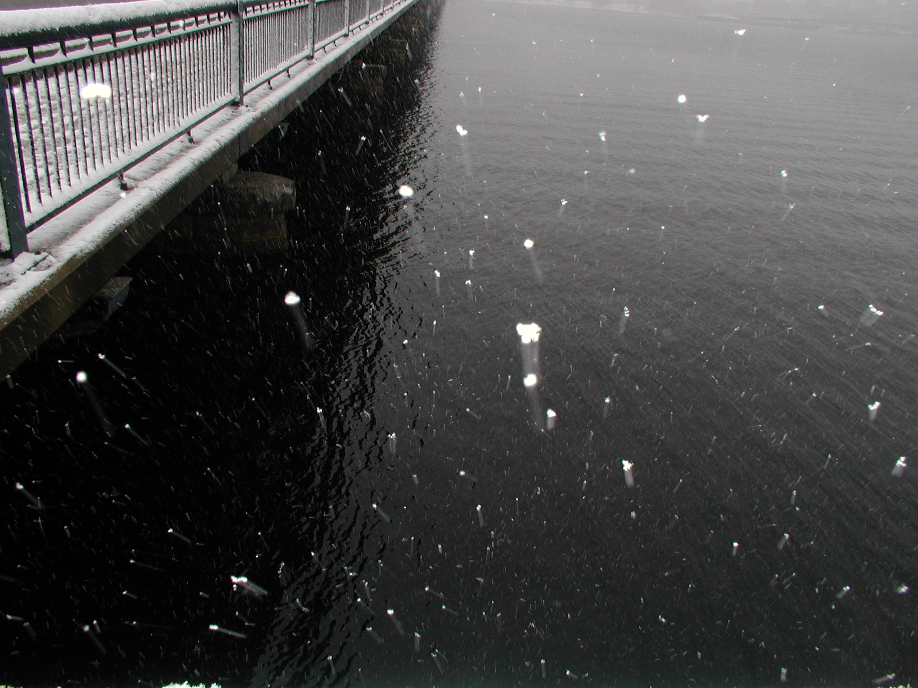
reference
Mark Wilde. arXiv:1106.1445. “From Classical to Quantum Shannon Theory” Last update Dec 2, 2015. 768 pages.

